Slide 1
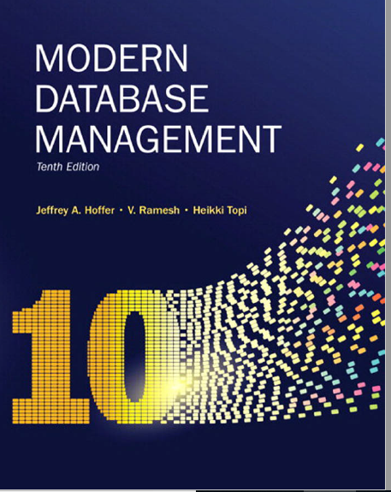
Chapter 1: The Database Environment and Development Process

Slide 2
Definitions
Database: organized collection of logically related data
Data: sored representations of meaningful objects and events
Structured: numbers, text, dates
Unstructured: images, video, documents
Metadata: data that describes the properties and context of user data
Information: data processed to increase knowledge in the person using the data
Notes:
Database: organized collection of logically related data – key word is related data which implies it is a database. Why Logical, not physical: doesn’t it have to be in the same data center?
Data: stored representations of meaningful objects and events - e.g. social media store posts, pictures etc.
Structured: numbers, text, dates
Unstructured: images, video, documents
Information: data processed to increase knowledge in the person using the data. The difference between data and information is that information increases knowledge.
Metadata: data that describes the properties and context of user data – or simply data about the data.

Slide 3

What is represented in the data below?
Notes:
Peoples name, Savings account number
Peoples name, Social security number!
Is this a record from department of revenue collection taxes, peoples name with SS#
Student names with ss#

Slide 4
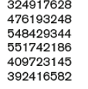

What do you see?
Notes:
Some numbers, and a number with decimal point
Could that be social security number and some sort of ranking
Could be account number and the amount
What is missing about the data to make it meaningful?

Slide 5
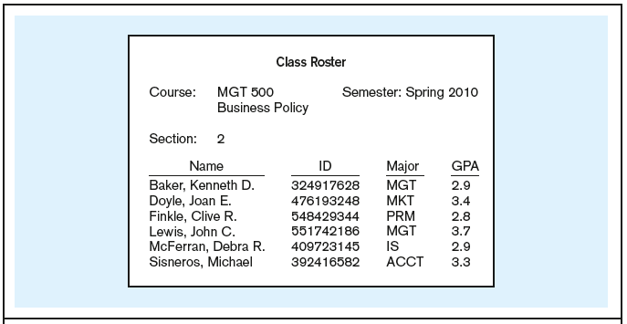
Figure 1-1a Data in context – converting data to Information
Context helps users understand data
Notes:
Data without context means nothing!
Only through context, one can understand the data.!
What metadata can you derive from this image?
Course: alpha numeric
Semester: alphanumeric
Section: numeric
Name: alphanumeric
GPA: decimal

Slide 6

Figure 1-1b Summarized data
Graphical displays turn data into useful information that managers can use for decision making and interpretation

Slide 7
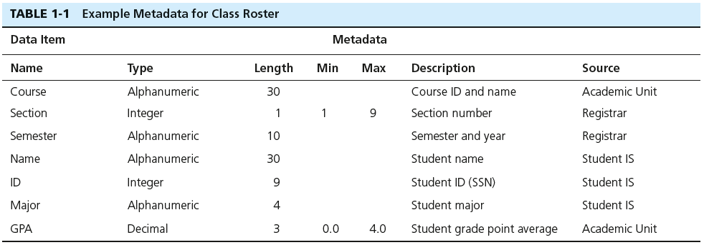
Descriptions of the properties or characteristics of the data, including data types, field sizes, allowable values, and data context
Notes:
Example of meta data – data about the data.

Slide 8
Questions
1. A database is an organized collection of ________ related data.
A) logically
B) physically
C) loosely
D) badly
2. Database management involves all of the following EXCEPT:
A) collecting data.
B) organizing data.
C) design web pages.
D) managing data.
3) Metadata typically describes all of the following EXCEPT:
A) data definitions.
B) length.
C) allowable values.
D) location on disk.
Notes:
A
C
D

Slide 9
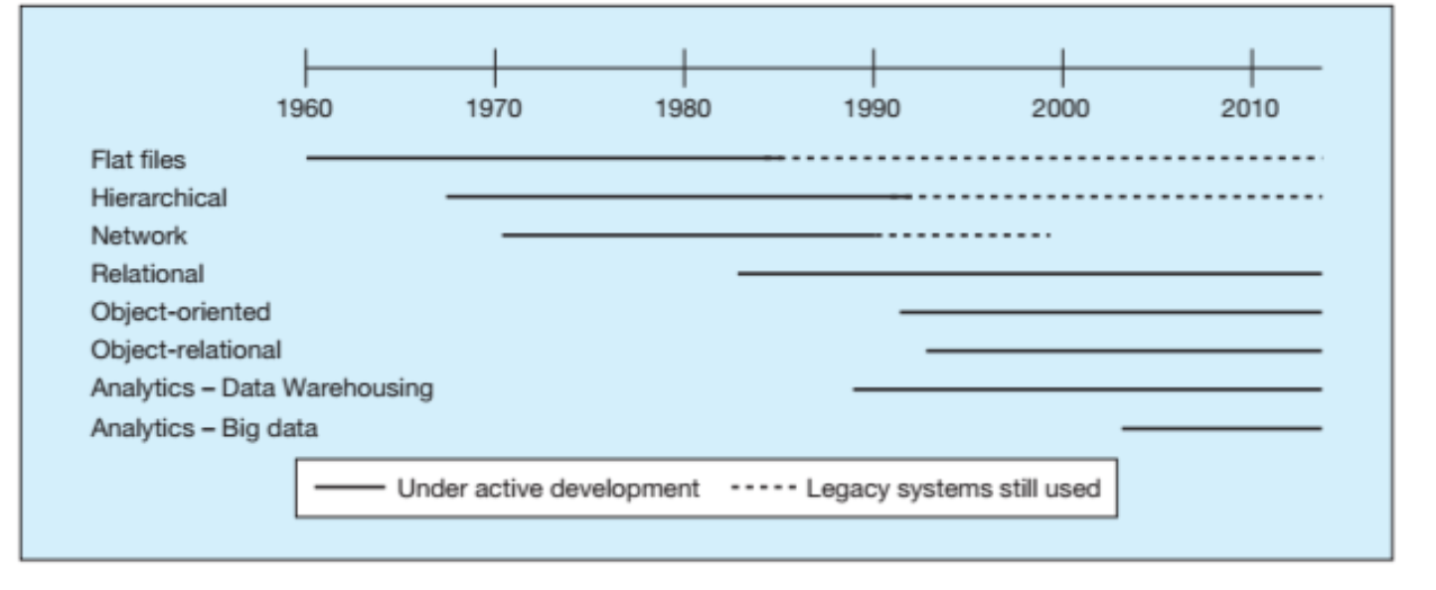
Figure 1-8a Evolution of database technologies
Notes:
What are the disadvantages of file processing?

Slide 10
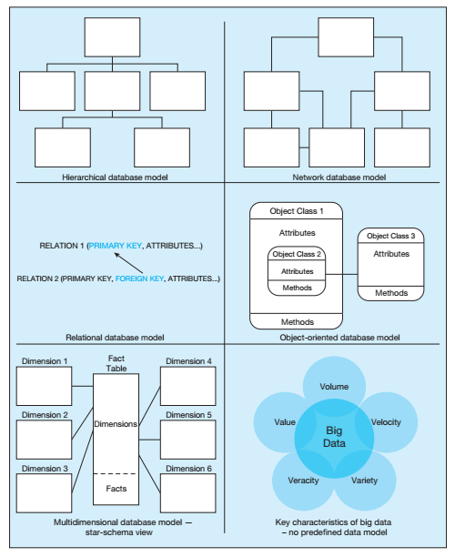

Slide 11
Disadvantages of File Processing
Program-Data Dependence
All programs maintain metadata for each file they use
Duplication of Data
Different systems/programs have separate copies of the same data
Limited Data Sharing
No centralized control of data
Lengthy Development Times
Programmers must design their own file formats
Excessive Program Maintenance
80% of information systems budget
Notes:
The first applications to solve the problems you tried to solve with the bank is creating of software systems.
Instead of storing the data on the paper

Slide 12
Problems with Data Dependency
Each application programmer must maintain his/her own data
Each application program needs to include code for the metadata of each file
Each application program must have its own processing routines for reading, inserting, updating, and deleting data
Lack of coordination and central control
Non-standard file formats
Notes:
Each application programmer must maintain his/her own data – Accounts Payable, Ordering system, Customer management system
Each application program needs to include code for the metadata of each file! - a file with customer on the third column, your code needs to always took at that position
Each application program must have its own processing routines for reading, inserting, updating, and deleting data – how to read data and update the data… may be different from app to app
Lack of coordination and central control – completely separate
Non-standard file formats – it could be tab delimited, comma delimited etc.

Slide 13
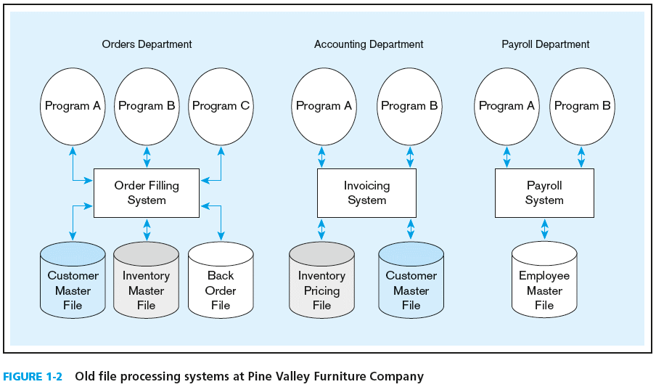
Duplicate Data
Notes:
Data Duplication
What is the issue with this picture?
Order Dept needs 3 files: customer, inventory, and back order
Acct dept needs inventory pricing and customer
Payroll needs employee file
What is the problem?

Slide 14
Problems with Data Redundancy
Waste of space to have duplicate data
Causes more maintenance headaches
The biggest problem:
Data changes in one file could cause inconsistencies
Compromises in data integrity

Slide 15
SOLUTION: The DATABASE Approach
Central repository of shared data
Data is managed by a controlling agent
Stored in a standardized, convenient form
Requires a Database Management System (DBMS)
Notes:
It solves most of the problems with file-based approach.
Central repository of shared data – many applications can connect to the same database
Data is managed by a controlling agent -> database agent controls the properties of database
Stored in a standardized, convenient form – in the forms of tables and columns

Slide 16
Database Management System
A software system that is used to create, maintain, and provide controlled access to user databases
Order Filing
System
Central database
Contains employee,
order, inventory,
pricing, and
customer data
Invoicing
System
DBMS
Payroll
System
DBMS manages data resources like an operating system manages hardware resources
Notes:
A software system that is used to create, maintain, and provide controlled access to user databases

Slide 17
Advantages of the Database Approach
Program-data independence
Planned data redundancy
Improved data consistency
Improved data sharing
Increased application development productivity
Enforcement of standards
Improved data quality
Improved data accessibility and responsiveness
Reduced program maintenance
Improved decision support

Slide 18
Elements of the Database Approach
Data models
Graphical system capturing nature and relationship of data
Enterprise Data Model–high-level entities and relationships for the organization
Project Data Model–more detailed view, matching data structure in database or data warehouse
Entities
Noun form describing a person, place, object, event, or concept
Composed of attributes
Relationships
Between entities
Usually one-to-many (1:M) or many-to-many (M:N)
Notes:
Begin to talk about data models, relationships

Slide 19
Enterprise Data Model
First step in database development
Specifies scope and general content
Overall picture of organizational data at high level of abstraction
Entity-relationship diagram
Descriptions of entity types
Relationships between entities
Business rules
Notes:
The very first step in the database project is to design an Enterprise data model.
First step in database development
Specifies scope and general content – are modeling a subsection of the business or the whole business. Whats’ in scope whats’ out of scope
Overall picture of organizational data at high level of abstraction – at this point no details are necessary, just high leverls
Entity-relationship diagram – how the entities related to one another
Descriptions of entity types – the description and high level business rules
Relationships between entities
Business rules

Slide 20
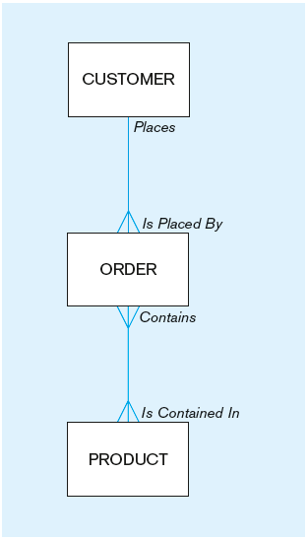
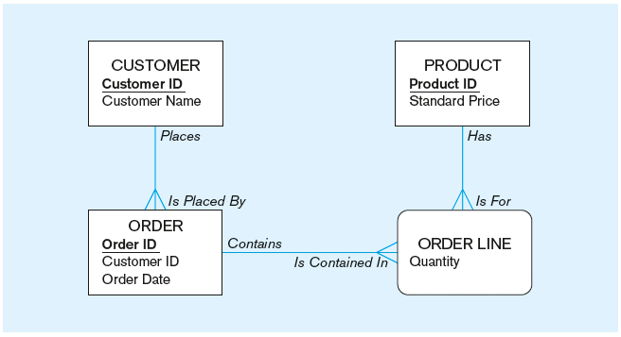
Figure 1-3 Comparison of enterprise and project level data models
Segment of an enterprise data model
Segment of a project-level data model
Notes:
Rectangular shape – entities
Lines ( in blue) – relationships
Verbs indicating the relationships. Notation
What is the difference between these two data models, the enterprise vs project level?
Comparison of enterprise and project level data models

Slide 21
One customer may place many orders, but each order is placed by a single customer
→ One-to-many relationship
Notes:
One to many relationship circled between customer and order

Slide 22
One order has many order lines; each order line is associated with a single order
→ One-to-many relationship
Notes:
Another example of one to many relashionship

Slide 23
One product can be in many order lines, each order line refers to a single product
→ One-to-many relationship
Notes:
One to many between order line and product

Slide 24
Therefore, one order involves many products and one product is involved in many orders
→ Many-to-many relationship
Notes:
Many to many relationship
Curly square here means it is an associative entity. We will cover different types of entities later.

Slide 25
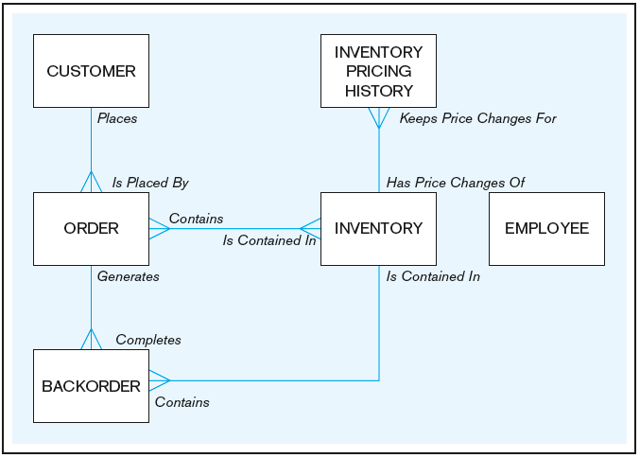

Example of Enterprise Data model
Notes:
Example of an enterprise model !!!!
Image this is an online retailer that sells books.

Slide 26
Questions
1) In a file processing environment, descriptions for data and the logic for accessing the data are built into:
A) application programs.
B) database descriptors.
C) fields.
D) records.
2) Which of the following is NOT an advantage of database systems?
A) Redundant data
B) Program-data independence
C) Better data quality
D) Reduced program maintenance
Notes:
1) A
b) A

Slide 27

Team Exercise? Think about it
Disadvantages of file processing includes:
Program-Data Dependence
Duplication of Data
Limited Data Sharing
Excessive Program Maintenance
Can these problems occur in 2020 even for organizations running relational database? Provide examples
Notes:
2011 study shows that data quality problems costed companies a trillion dollars.

Slide 28
Data Financial cost
According to Gartner research, “the average financial impact of poor data quality on organizations is $9.7 million per year.” IBM also recently discovered that in the US alone, businesses lose $3.1 trillion annually due to poor data quality.
https://www.anodot.com/blog/price-pay-poor-data-quality/
Notes:
Causes of data quality issues:
Duplicate data
Data transformation errors
Proliferation of systems
Unplanned systems

Slide 29
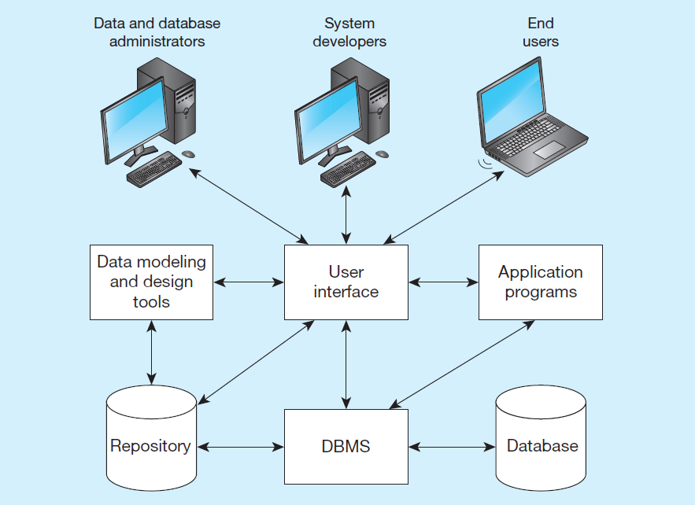
Components of the Database Environment
Notes:
Data modeling and design tools are automated tools used to design databases and application programs. These tools help with creation of data models and in some cases can also help automatically generate the “code” needed to create the database.
A repository is a centralized knowledge base for all data definitions, data relationships, screen and report formats, and other system components. In other words, the metadata resides in the repository.
DBMS is a software system that is used to create, maintain, and provide controlled access to databases. A database is an organized collection of logically related data, usually designed to meet the information needs of multiple users in an organization. A database is not the same as a repository. The database contains data, whereas the repository contains metadata. In other words, the repository defines the structure of the data.
Application programs interact with the database to provide functionality of use for the company. Relating this to figure 1-2, the application programs fulfill the order processing, invoicing, and payroll functions.
The user interface includes languages, menus, and other facilities by which users interact with various system components. Most application programs will involve user interfaces, because they will be directly used by people (users). However, not all applications involve user interfaces; some are run as batch programs in the background. For example, a program that prints paychecks may not include a user interface.
Different types of users include data and database administrators, system developers, and end users. The data administrators manage the data and database. The developers create the application programs. The end users are people who use the systems for various business functions. These can include accountants, sales people, managers, etc. Database administrators and system developers are IT people, and their principal clientele are end users.

Slide 30
Components of the Database Environment
Data modeling and design tools – automated tools used to design databases and application programs
Repository – centralized storehouse of metadata
Database Management System (D B M S) – software for managing the database
Database – storehouse of the data
Application Programs – software using the data
User Interface – text, graphical displays, menus, etc. for user
Data/Database Administrators – personnel responsible for maintaining the database
System Developers – personnel responsible for designing databases and software
End Users – people who use the applications and databases

Slide 31
The Range of Database Applications
Personal Databases
Typical size in the megabytes
Intended for one user
Departmental Multi-Tiered Client/Server Databases
Typical size in the gigabytes
Intended for several users, usually doesn’t exceed 100, department-wide
Enterprise Applications
Typical size in the gigabytes, terabytes, or even petabytes
Intended for a very large user base, company wide
Notes:
Personal databases -> databases that sits on a user device. For example MS Access, databases on your cell phone etc.
Two-tier Client/Server databases -> that is having an application/ typically a desktop application that connects directly to a db. Used in small companies for specifictype of applications
Multitier Client/Server databases -> more than one tire, they may be a web-service that separates the db from the application such as SOP OR REST
Enterprise applications
Enterprise resource planning (ERP) systems such as SAP and Oracle ERP applications
Data warehousing implementations

Slide 32
Enterprise Database Applications
Enterprise Systems (typically involve relational databases)
Backbone of an organization
Enterprise resource planning (E R P)
Customer relationship management
Supply chain management
Human resource management and payroll
Data Warehouses (typically involve relational databases)
Integrates data from multiple data sources
Maintain historical data
Help identify patterns and trends
Data Lakes (often don’t involve relational databases)
Large integrated repository for internal and external data that does not follow a predefined schema
Notes:
Enterprise DB are the engine behind operations of an organization

Slide 33
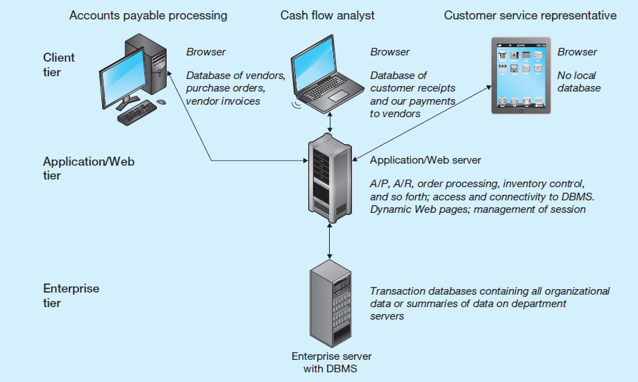
Multi-tiered Client server Database Architecture
Notes:
For a smaller companies, or a just a single department.

Slide 34
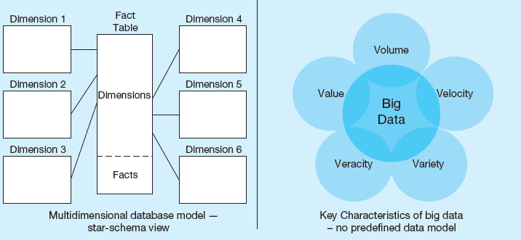
Informational systems
Non-operational Database architectures
Notes:
Multidimensional models are typically based on data warehouses and are used for decision support purposes. The star schema is a typical data warehouse structure. It’s still a relational database, but here there are two types of tables. Fact tables contain numerical data that can be aggregated (prices, sales revenue, payments, etc.). Dimensions are different “lenses” by which you can slice and dice the numerical data (customers, departments, products, time periods, etc.). The term Online Analytical Processing (OLAP) refers to the types of systems that use multidimensional data.
Big data is an emerging concern and opportunity for business. This refers to the huge amount of often unstructured data (such as tweets, customer reviews, blogs, emails, etc.) that are increasingly important for business decision-making. The Vs (volume, velocity, variety, veracity, and value) are big buzzword in the big data world.

Slide 35
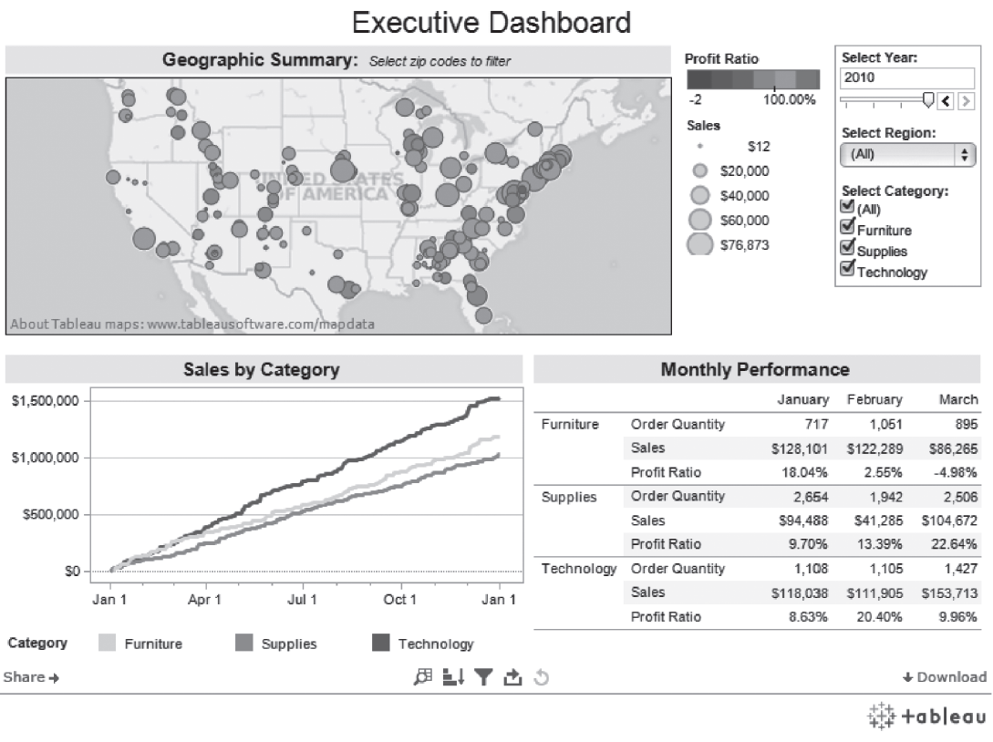
An Example of an Executive Dashboard
(http://public.tableausoftware.com/profile/mirandali#!/vizhome/Executive-Dashboard_7/ExecutiveDashboard)
Courtesy Tableau Software
Notes:
Figure 1-13 presents an example of what an output from a data warehouse might look like.

Slide 36

Database Development Methodology
What is the process of implementing database solutions?
Notes:
Informational systems or processing system, there is process on how they are developed

Slide 37
Two Approaches to Database and IS Development
System Development Life Cycle (SDLC Traditional)
Detailed, well-planned development process
Time-consuming, but comprehensive
Long development cycle
Rapid application development (RAD)
Cursory attempt at conceptual data modeling
Define database during development of initial prototype
Repeat implementation and maintenance activities with new prototype versions
Example: prototyping

Slide 38
Systems Development Life Cycle (see also Figure 1-10)
Planning
Analysis
Logical Design
Physical Design
Implementation
Maintenance
Notes:
6 phases of Traditional SDLC process. Each phase is dependent on the other

Slide 39
Systems Development Life Cycle (see also Figure 1-10) (cont.)
Planning
Purpose–preliminary understanding
Deliverable–request for study
Planning
Analysis
Logical Design
Physical Design
Database activity–
enterprise modeling and early conceptual data modeling
Implementation
Maintenance
Notes:
Step 1 -> Enterprise database modeling/ conceptual data modeling. Understanding the requirements at a high level

Slide 40
Systems Development Life Cycle (see also Figure 1-10) (cont.)
Purpose–thorough requirements analysis and structuring
Deliverable–functional system specifications
Planning
Analysis
Analysis
Logical Design
Physical Design
Database activity–thorough and integrated conceptual data modeling
Implementation
Maintenance
Notes:
thorough requirements analysis and structuring
Deliverable–functional system specifications! Project level data conceptual data model

Slide 41
Systems Development Life Cycle (see also Figure 1-10) (cont.)
Purpose–information requirements elicitation and structure
Deliverable–detailed design specifications
Planning
Analysis
Logical Design
Logical Design
Physical Design
Database activity–
logical database design (transactions, forms, displays, views, data integrity and security)
Implementation
Maintenance
Notes:
Purpose–information requirements elicitation and structure
Deliverable–detailed design specifications!
In this step, you figure out the data types etc.

Slide 42
Systems Development Life Cycle (see also Figure 1-10) (cont.)
Purpose–develop technology and organizational specifications
Deliverable–program/data structures, technology purchases, organization redesigns
Planning
Analysis
Logical Design
Physical Design
Physical Design
Database activity–
physical database design (define database to DBMS, physical data organization, database processing programs)
Implementation
Maintenance
Notes:
Deliverable–program/data structures, technology purchases, organization redesigns
Database activity–
physical database design (define database to DBMS, physical data organization, database processing programs)

Slide 43
Systems Development Life Cycle (see also Figure 1-10) (cont.)
Purpose–programming, testing, training, installation, documenting
Deliverable–operational programs, documentation, training materials
Planning
Analysis
Logical Design
Physical Design
Database activity–
database implementation, including coded programs, documentation, installation and conversion
Implementation
Implementation
Maintenance
Notes:
Database activity–
database implementation, including coded programs, documentation, installation and conversion

Slide 44
Systems Development Life Cycle (see also Figure 1-10) (cont.)
Planning
Purpose–monitor, repair, enhance
Deliverable–periodic audits
Analysis
Logical Design
Physical Design
Database activity–
database maintenance, performance analysis and tuning, error corrections
Implementation
Maintenance
Maintenance
Notes:
Database activity–
database maintenance, performance analysis and tuning, error corrections

Slide 45
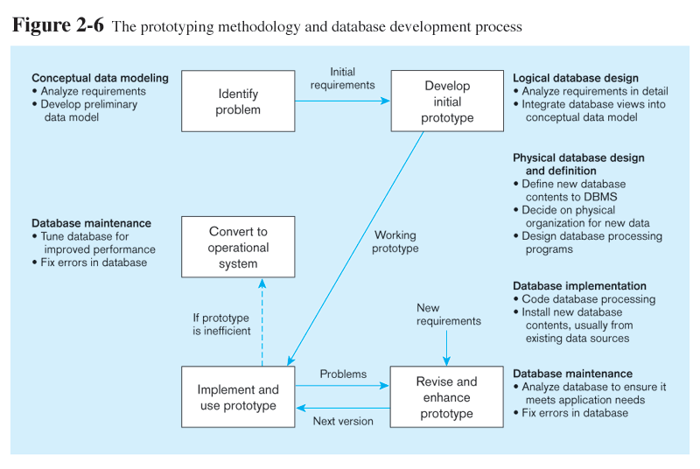
Prototyping Database Methodology (Figure 1-11)
Notes:
Rapid prototyping –
Step 1 next

Slide 46
Prototyping Database Methodology (Figure 1-11) (cont.)
Notes:
Problem identification
Conceptual data model

Slide 47
Prototyping Database Methodology (Figure 1-11) (cont.)
Notes:
Step two.
Analyze the re requirements in details
Integrate the database views into conceptual data model

Slide 48
Prototyping Database Methodology (Figure 1-11) (cont.)
Notes:
Physical DB implementation.
Revise and necessary

Slide 49
Prototyping Database Methodology (Figure 1-11) (cont.)
Notes:
If all is working as expected
Tune the db for performance etc.

Slide 50
Alternative Information Systems Development Approaches
Traditional S D L C: methodical, structured, and time consuming
Rapid Application Development (R A D): faster and more adaptive, especially when a database is already in place
Several flavors:
Prototyping
Agile methodologies
eXtreme programming
Scrum
D S D M (dynamic system development methodologies)
Notes:
Agile software development emphasizes “individuals and interactions over processes and tools, working software over comprehensive documentation, customer collaboration over contract negotiation, and response to change over following a plan.”

Slide 51
Problem
Questions
What is the difference between Enterprise data model, Project-level data model and Conceptual data model?
Which phase of the SDLC are each type of modeling done?
Notes:
1)Enterprise data model is high level, only concerned with entities and relationships. Project Level data model deals with the attributes of each entity, and recognition of additional entities
Both are type of conceptual data model!
2) Planning – Enterprise Data Model
Analysis – Project Level Data Model!

Slide 52
Managing Projects
Project–a planned undertaking of related activities to reach an objective that has a beginning and an end
Involves use of review points for:
Validation of satisfactory progress
Step back from detail to overall view
Renew commitment of stakeholders
Notes:
Project– each has has a beginning and an end. It may involve different stakeholders
Involves use of review points for:
Validation of satisfactory progress
Step back from detail to overall view
Renew commitment of stakeholders

Slide 53
Managing Projects: People Involved
Business analysts – analyze business situation and establish requirements
Systems analysts – like business analysts, but also have technical expertise for overall information systems
Database analysts and data modelers – analysts who focus on database
Users – the “customers” communicate their needs to analysts
Programmers – coders of the programs that interact with the database
Notes:
Folks involved.
Depends from company to company

Slide 54
Database Project Team Members
Database architects – establish standards for data in business units
Data administrators – responsible for existing databases, ensuring data integrity and consistency
Project managers – oversee the projects, manage the personnel
Other technical experts – network, operating system, documentation, etc.
Notes:
There are many different people, each with different perspectives, skills, and needs, involved in a systems development project.

Slide 55

Founder of DBMS
Notes:
He first wrote a paper of managing data through RDMBS in 1970. He worked for IBM

